Slide 1
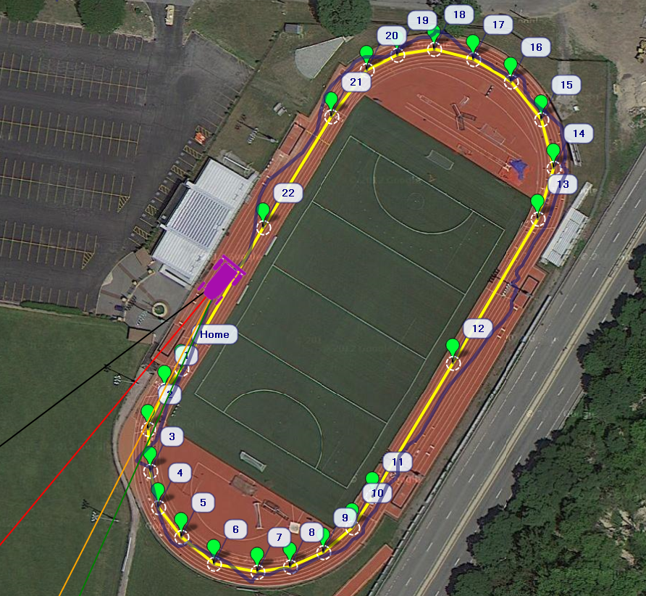
Control Design and Implementation of a Small-Scale Autonomous Hovercraft
University of Massachusetts Lowell
James B. Francis College of Engineering
Department of Mechanical Engineering Capstone
Ryan Mackay
Joshua Bevan
Nicholas Lutz
Mario Stamatiou

Slide 2
Introduction
Hovercrafts present a unique control challenge
It is an under-actuated system
3 DOF of motion, 2 DOF of control
Requires optimization techniques to operate
The objective was to develop a robust control of the platform
Using GPS and inertial data provided by the IMU
Autonomously navigate between set waypoints

Slide 3
Overview
Hovercraft Platform
Theory
Mechanical Systems
APM
Design Methodology
Control Algorithm
Concepts
Inertial frame and body frame-dynamics of hovercraft
Inertial frame and body frame-kinematics of hovercraft
Set Point detection-turning
Setpoint detection-cruising
Implementation
Procedures and Methods for Design
Code Generation
Ground Control
Results and Analysis
Non-Optimized Track Test
Cross Track Error Optimized Track Test
Steering/Crosstrack Optimized & Box Test
Stability Dependence on Initial Conditions
Further Study
Special Thanks

Slide 4
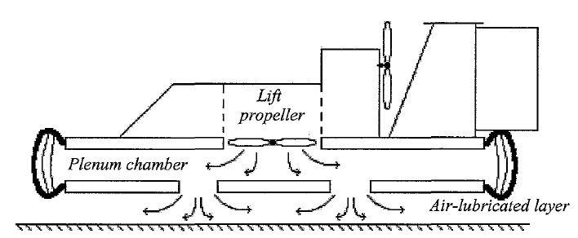
Theory
Hovercraft Platform
Lift Fan supplies air pressure filling the cavity and inflating the skirt
Once the air pressure equals the weight of the hovercraft the hover craft lifts and air escapes from the outlet ducts.
The escaping air creates a thin layer of air between the skirt and ground allowing the hovercraft to float over the ground.

Slide 5
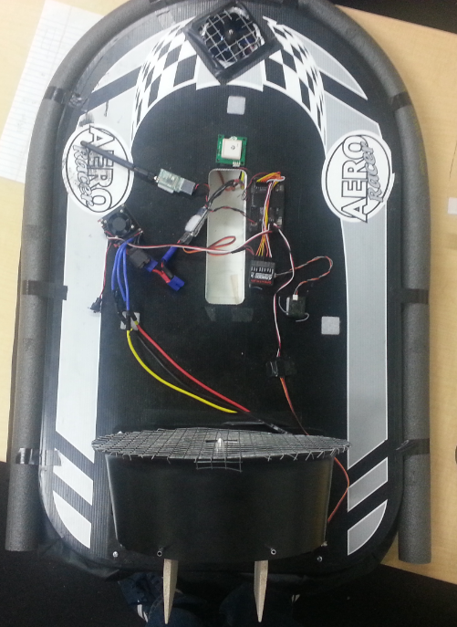
Mechanical Systems
Hovercraft Platform
Modified model hovercraft
Servo driven rudder system.
Single propeller thrust and lift fans.
Powered by 2000mAh NiMH and 3200mAh 4S LiPo batterys.

Slide 6
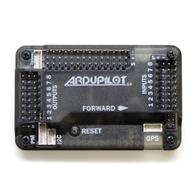
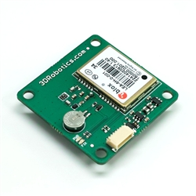
Electronics
Hovercraft Platform
APM 2.5+ Assembled (Top entry) with 915Mhz (US) Telemetry Set
3-axis gyro, accelerometer and magnetometer, along with a high-performance barometer
Onboard 4 MP Dataflash chip for automatic datalogging
Arduino Compatible
APM
3DR GPS uBlox LEA-6
5 Hz update rate
25 x 25 x 4 mm ceramic patch antenna
38 x 38 x 8.5 mm total size, 16.8 grams.
GPS

Slide 7
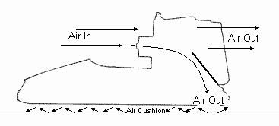
Design Methodology
Hovercraft Platform
Steering Mechanism
Rudder
More challenging control scheme due to parasitic thrust
Differential Thrust
Capability of turning in place, allowing more sophisticated control
Lift Mechanism
Flow Directing Duct
Uses a single fan, but requires thrust at all times during operation
Separate Lift Fan
Allows low thrust without losing lift
Microcontroller/ IMU
PX4
More powerful processor
APM
More thoroughly documented source code and tutorials

Slide 8
Control Algorithm
Concepts that were applied for development of control algorithm
Uses of Inertial frame and body frame for dynamic and kinematic analysis
The hovercraft is an under-actuated vehicle since there are three degrees of freedom and only two available control inputs.
Line of sight for detecting setpoints while turning and cruising
Control theory application

Slide 9
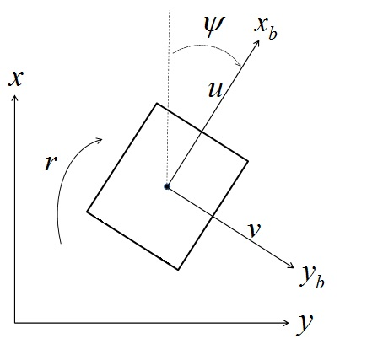

Inertial body frame dynamics
Control Algorithm
$x:$ East
$y$: North
$x_{b}$: forward direction on body-fixed frame ; ${\dot{x}}_{b}$:surge
$y_{b}$: right direction on body-fixed frame; ${\dot{y}}_{b}$: sway
$r$: angular velocity
Both Inertial frame and body-fixed frame are used for development of control algorithm
Inertial frame assumes a fixed origin. The Earth is assumed to be the origin of the inertial reference frame
Coordinates are defined in inertial reference frame
Force, moment velocity and acceleration are defined in body-fixed frame

Slide 10
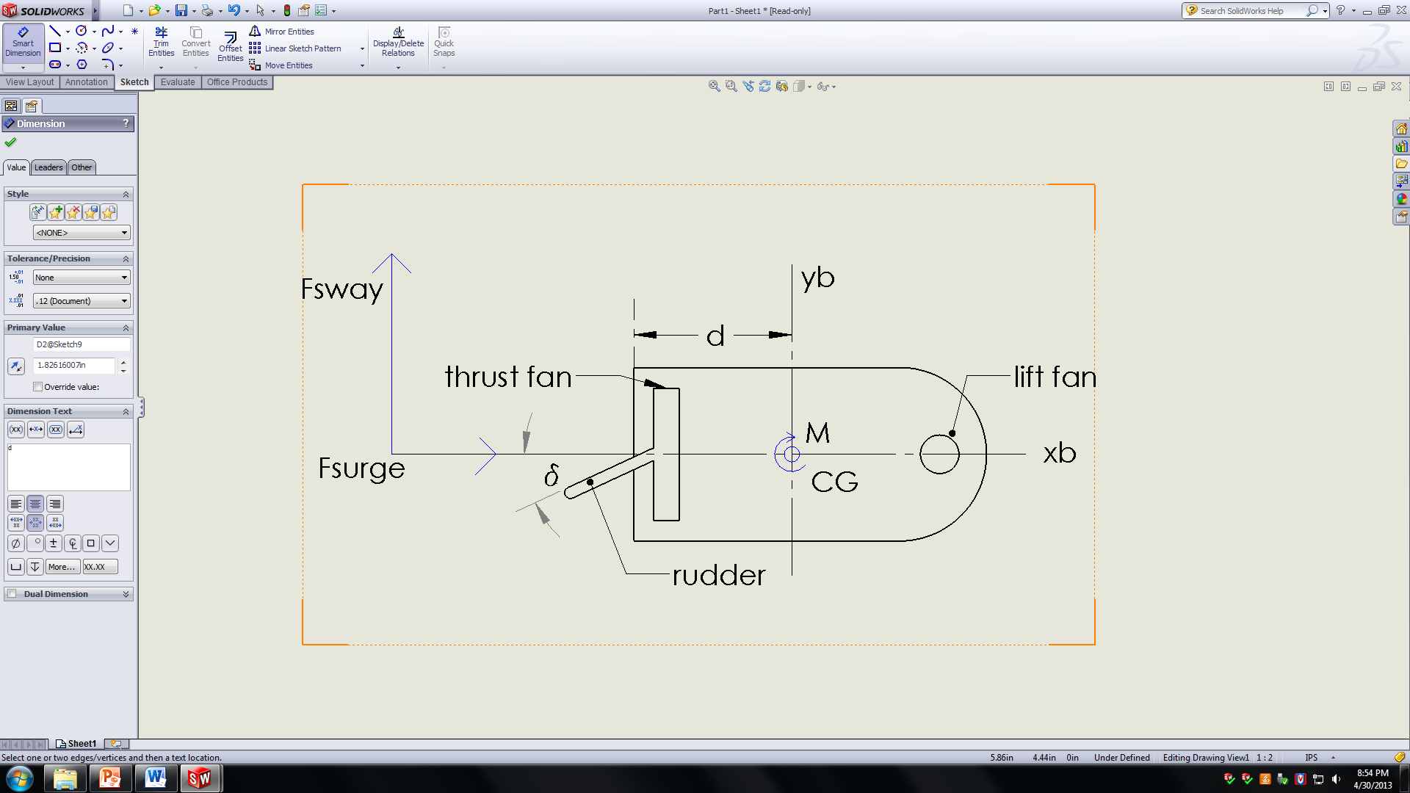


Inertial frame and body frame-kinematics
Control Algorithm
Re-direction of thrust from rudder creates $F_{xb}$ and $F_{yb}$
$F_{yb}$ generates a moment causing the hovercraft to turn;
Amount of thrust is expressed as a percentage relative to the maximum
From Newton’s 2nd Law
(assuming sway and kinetic friction are negligible)
$$\dot{u}=\frac{b}{m}F_{thrust,surge}=>\dot{u}∝T\%$$
$\dot{r}=\frac{1}{I_{z}}dT\%δ$ => $\dot{r}∝∆\%$

Slide 11
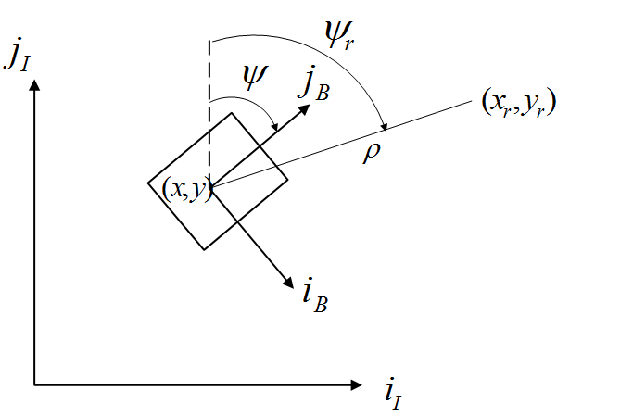


Set Point detection-turning
Control Algorithm
$ψ_{r}$: angle of hovercraft in inertial frame w.r.t line of setpoint
ψ: angle of hovercraft in inertial frame w.r.t surge component
($x_{r},y_{r})$: setpoint coordinates
$e_{ψ}=ψ−ψ_{r}$ ; ψ_{r}= $\tan^{−1}{(\frac{y_{r}−y}{,x_{r}−x})}$
Hovercraft relies on line of sight to identify setpoint
The following condition has to be satisfied to identify setpoint
$\left|e_{ψ}\right|≤ \frac{ε}{2}$
where ε is a waypoint angle that bisects $j_{B}$

Slide 12


Setpoint detection-cruising
Control Algorithm
Once alignment is achieved the hovercraft translates until ($x_{r, }y_{r})$ is reached. The distance ρ is given by:
$ρ=\sqrt{{(x_{r}−x)}^{2}+{(y_{r}−y)}^{2}}$
A waypoint radius R is defined to let the board know when the hovercraft has reached the setpoint.
The point will have been reached under the condition
$ρ≤\left|R\right|$

Slide 13
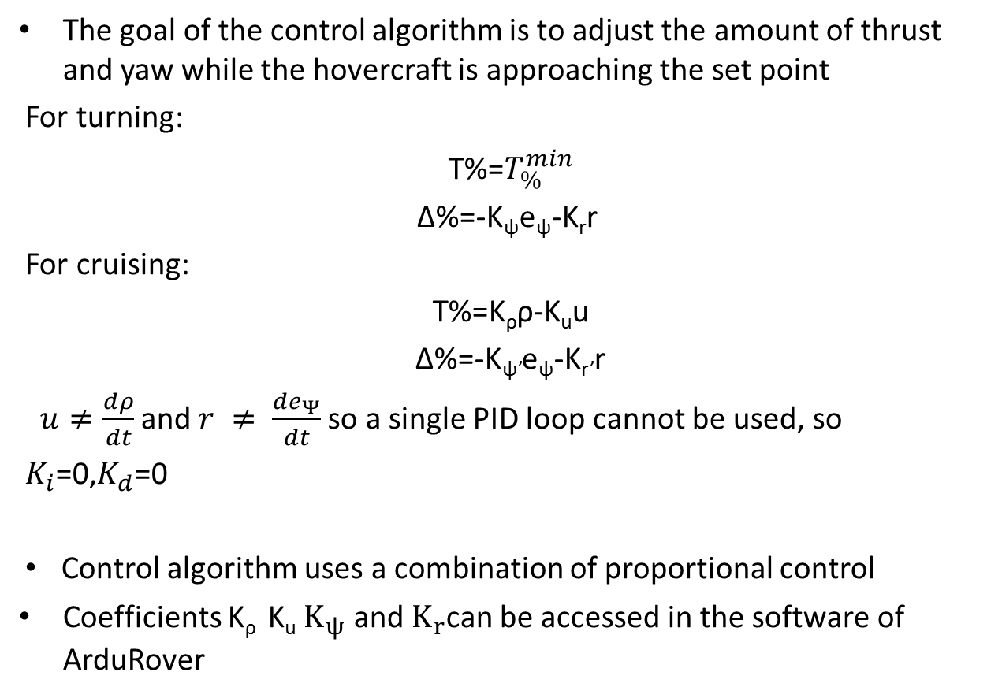
Control Algorithm
Implemented Algorithm
The goal of the control algorithm is to adjust the amount of thrust and yaw while the hovercraft is approaching the set point
For turning:
T%=$T_{\%}^{min}$
∆%=-K_{ψ}e_{ψ}-K_{r}r
For cruising:
T%=K_{ρ}ρ-K_{u}u
∆%=-K_{ψ’}e_{ψ}-K_{r’}r
$u≠\frac{dρ}{dt}$and$r ≠ \frac{de_{Ψ}}{dt}$ so a single PID loop cannot be used, so
$K_{i}$=0,$K_{d}$=0
Control algorithm uses a combination of proportional control
Coefficients K_{ρ} K_{u} $K_{ψ}$ and $K_{r}$can be accessed in the software of ArduRover

Slide 14
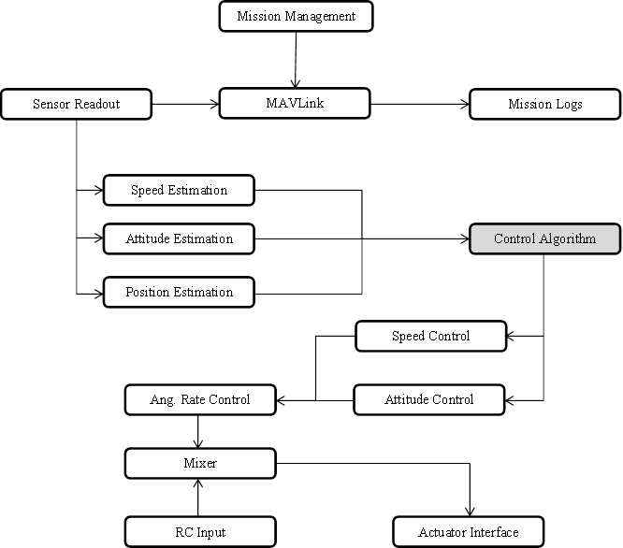
Procedures and Methods for Design
Implementation

Slide 15
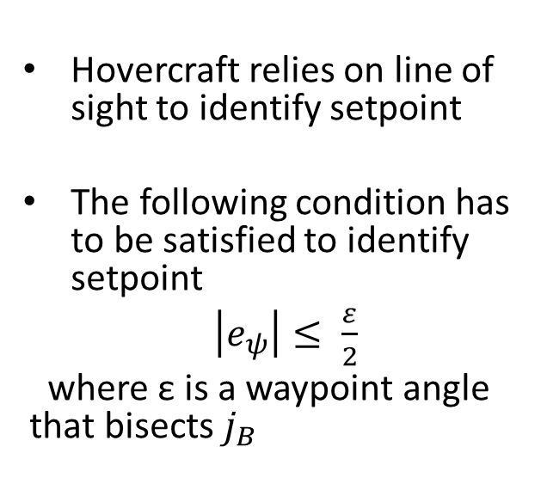
Methods for Design
Implementation
Pseudo Code implementation of Control Algorithm
Differentiates between turning and cruising
Because $u≠\frac{dρ}{dt}$in $T\%= k_{ρ}ρ−k_{u}u,$we use the sum of P’s rather than full PID’s.
Use generic PID function for generality
1|PID ρ_pid, u_pid, Ψ_pid, r_pid;
2|if ( |bearing_error| < max angle for cruise )
3| Target_speed = cruise_speed + ρ_pid( distance_to_waypoint, kp=K_{ρ} , ki=0, kd=0 )
4| Target_speed = Target_speed + ρ_pid( ground_speed, kp=K_{u} , ki=0, kd=0 )
5|else
4| Target_speed = cruise_speed
5|T% = calc_throttle( Target speed )
6|Limit T%^{min} ≤ T% ≤ T%^{max}
7|∆% = Ψ_pid( sin(bearing_error), kp=K_{ψ} , ki=0, kd=0 )
8|∆% = r_pid( omega.z, kp=K_{r} , ki=0, kd=0 )
9|∆% = (∆%)(cruise_speed/ground_speed)

Slide 16
Generated Code
Implementation

Slide 17
Implementation
Generated Code

Slide 18
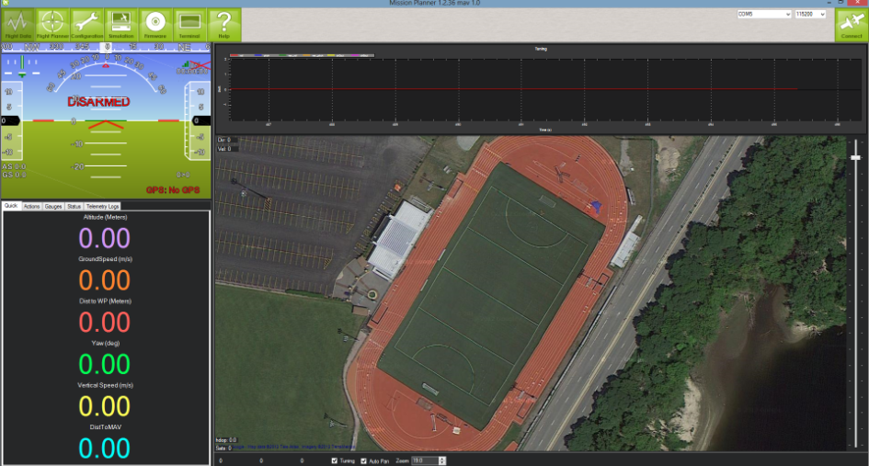
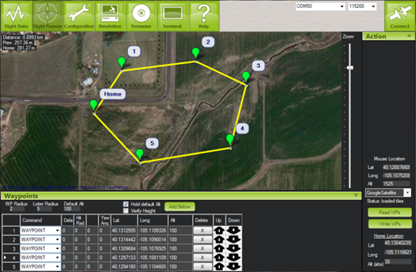
Ground Control
Implementation

Slide 19
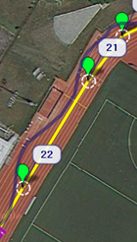
Non-Optimized Track Test
Results and Analysis

Slide 20
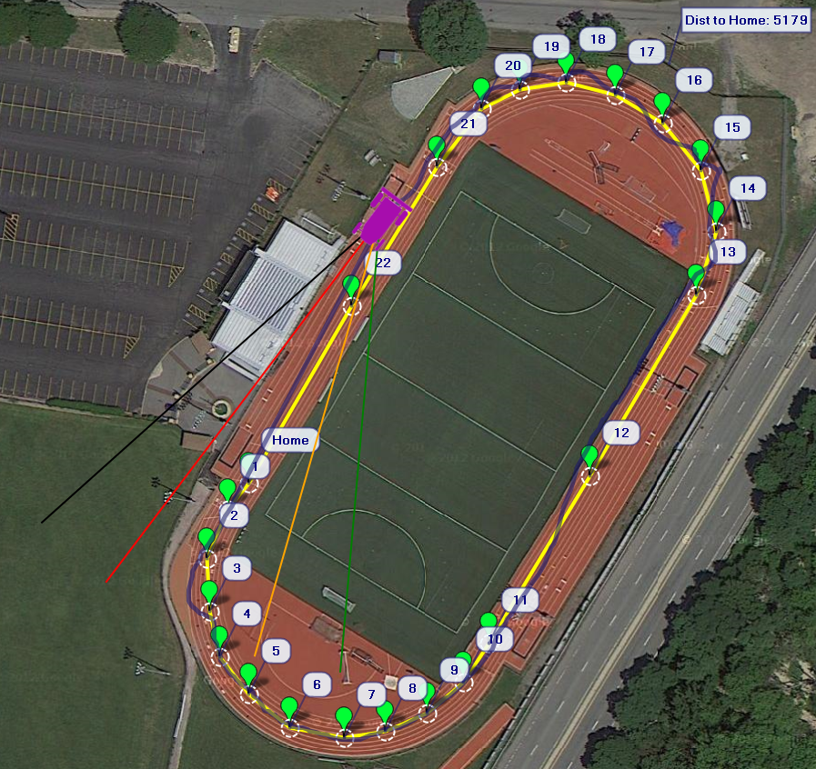
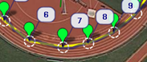
Cross-Track Error Optimization
Results and Analysis

Slide 21
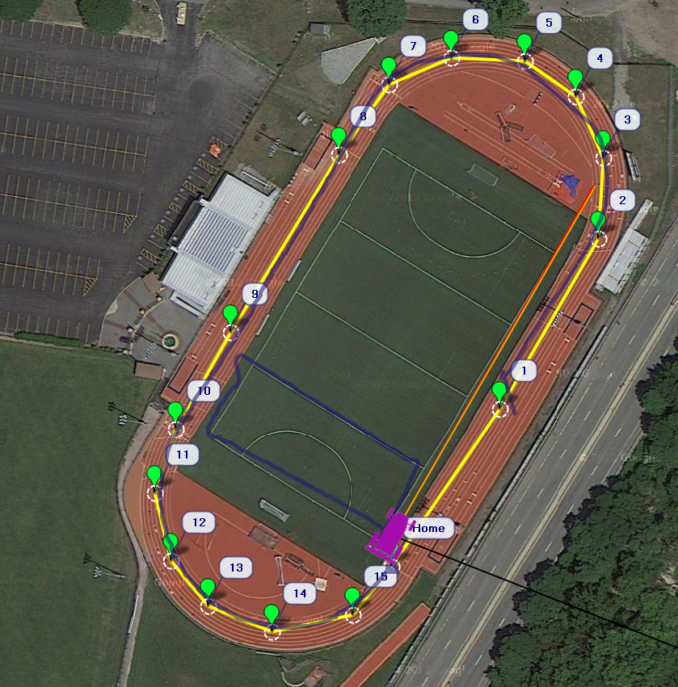
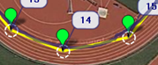
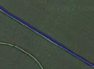
Steering/Crosstrack Optimization
Results and Analysis

Slide 22
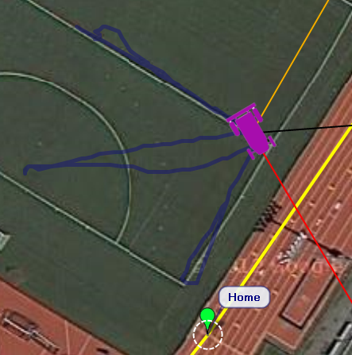
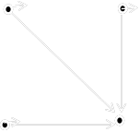
Stability Dependence on Initial Conditions
Results and Analysis

Slide 23
Further Study
Investigate terrain sensing
Infer terrain properties from inertial data and adjust lift in response
Explore path optimization
All waypoints are available at the start of flight
It should be possible to look forward in the path and plan actions beforehand
Develop controls to be used with a craft using differential thrust
Decoupling turning moment and thrust allows path optimization to be explored
Use sonar capabilities for obstacle avoidance
ArduRover software has the capability of doing obstacle avoidance
Adding a sonar module, autonomous navigation could be improved

Slide 24
Special Thanks
We would like to acknowledge the efforts of Professor Raptis in acting as our capstone advisor. His contributions to our understanding of the theoretical and practical implementations of the control algorithm were invaluable. We would like to thank all the professors of the Mechanical Engineering Department for providing us the knowledge that was applied in successfully achieving the goal of this project. Additionally, we would like to thank RC Buyer’s Warehouse of Nashua, NH for providing advice on equipment selection.

